Slide 1
TEALS Minecraft Project
Connor Hollasch & Steve Hollasch

Slide 2
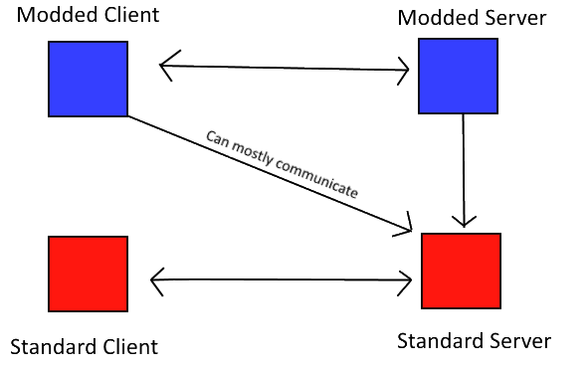
Mods
Server modifications (plugins)
Used on standard client
Modifies current game assets
Client modifications
Create or modify game assets
Only works on servers with the same mod

Slide 3

Implementation
Everything’s Written in Java
A Minecraft world is composed of items, blocks, and entities
items — Objects in the Minecraft world
blocks — Define the world landscape (in a 3D grid)
entities — Players, creatures and robots that move around the world

Slide 4
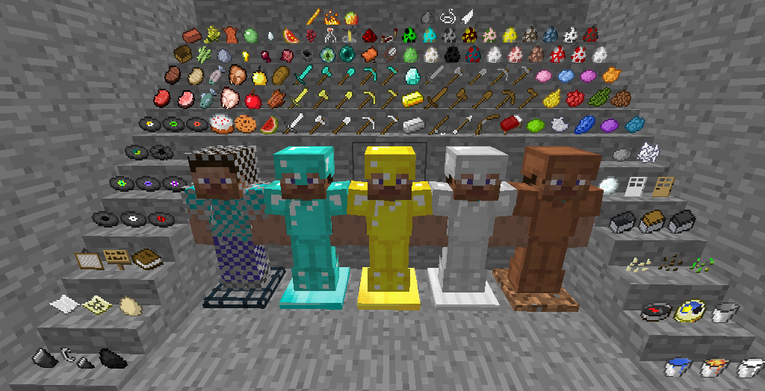
How Minecraft Works – Items
Contained within the world
Players can “carry” items
Types include: food, weapons, armor, tools, or just default item
Can be dropped / picked up in world
Example items include: potato, gunpowder, gold sword, book

Slide 5
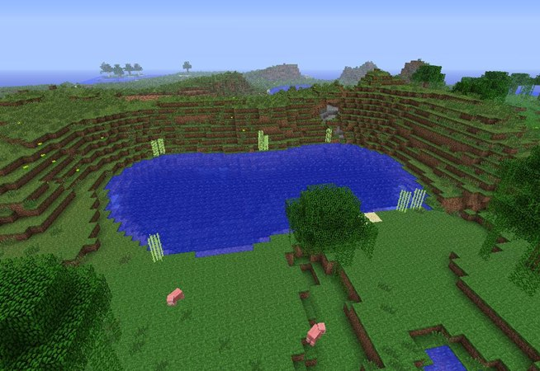
How Minecraft Works - Blocks
The world is made up of blocks
Blocks can be broken or placed
Some items place blocks
Example blocks include: stone, dirt/grass, leaves, wood, grass

Slide 6
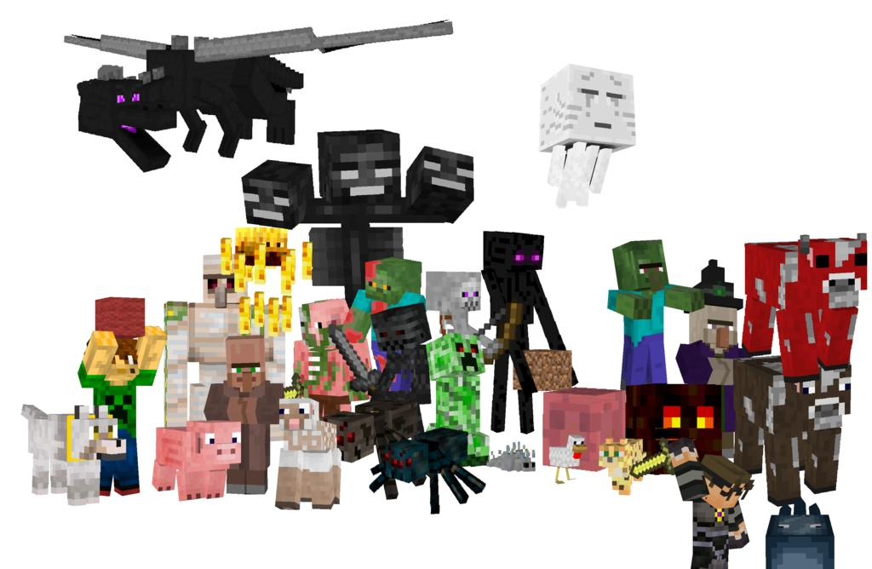
How Minecraft Works – Entities
Entities are placed randomly around the world
Entities have autonomous behaviors
Can be friends, foes or neutral
Entities include: skeleton, sheep, cow, pig, wolf

Slide 7
TEALS Minecraft – Goals
Designed to build on everything your APCS students have learned to date.
Project is hosted publicly on GitHub, so open to bug reporting, examination, contributions, and other project contributions. We can also host a public wiki for further feedback.
Lasts 2–3 weeks. Your actual time will vary.
9 labs total, many more possible. Each lab has summary at the start for the APIs required for that lab, plus multiple phases of implementation for continuing feedback.
Lectures provided in PowerPoint and PDF formats.
Lab solutions and other instructor-only materials available to instructors in the GitHub APCSA repository (/projects/minecraft/).

Slide 8
TEALS Minecraft — Materials
This project uses the Forge modding API
A modding package for clients
Has the ability to mod server, but not implemented for this curriculum
Instructors/Students Distribution
Zip file containing source code
Designed to work on Eclipse or IntelliJ. Other IDEs possible, but that's up to additional developers/instructors/students.
Documentation for lectures, student guides and labs
Single File Setup
Zip file from public GitHub repo,
or as a locally-copied file (about 180MB).

Slide 9
Lab Demo — Tree-Growing Blocks
A quick demonstration of lab 5, where students create “seed” blocks that end up growing different types of trees: cube, sphere, cylinder, and cone.

Slide 10
Contact Info
Connor Hollasch connor@hollasch.net GitHub: chollasch
Steve Hollasch steve@hollasch.net GitHub: hollasch
Main TEALS GitHub Org http://tealsk12.github.io
Teals-Minecraft Web Site http://tealsk12.github.io/teals-minecraft
Teals-Minecraft Instructor Chat on Slack https://tealsk12.slack.com ‘tealsmc’ channel

